Slide 1
New Jersey’s Data Deletion Law
P.L. 2023, C.314 Thursday – March 7, 2024
James B. Appleton
President – NJ CAR
Greyson P. Hannigan
Director of Legal & Regulatory Affairs

Slide 2
1. Overview of the Law 2. Charging a Reasonable Fee 3. Overview of Motor Vehicle Data Deletion Notice 4. Dealership options 5. What are dealerships doing now?

Slide 3
Overview of the Law
What does the law Require?
When Dealer takes possession of a Motor Vehicle
Purchase, Trade-In, Lease Return, arguably loaner return and Demo
Resale or lease
Includes wholesaling
“Offer” to delete
Advise the customer of the law and its requirements
Personal Information includes “but is not limited to”:
Navigation History, Geolocation data, Media Data
Phone Contacts, biometric data, internet browsing history
Garage Door Codes, gate codes, keyless entry codes
Payment Information, Text records
Grassroots Network
Notes:
P.L. 2023, c.314 Requires a motor vehicle dealer who takes possession of a motor vehicle from a consumer for the purpose of resale or lease to offer to delete the consumer’s personal information from the vehicle.
Personal Information – Navigation History, Paired Phones, Garage Door Codes. Paired Phones could include all the other items listed.

Slide 4
Data clearing protocols must be in accordance with Guidelines for Media Sanitization by the National Institute of Standards and Technology (NIST)
Techniques specified by Manufacturer to overwrite data
Menu option to reset the vehicle to the original factory settings
● Penalties for violations
● First Offense – Civil Penalty of $500
● Any Subsequent offense – Civil Penalty of $1000
● Enforced by Division of Consumer Affairs
● Enforcement Action in the Superior Court
Grassroots Network
Notes:
1. Doing a factory reset complies with the law. However, It is important to note that resetting the vehicle to factory settings may not guarantee that all personal information is completely removed. A more comprehensive deletion process may be necessary. NJ CAR is exploring what those options could be.

Slide 5
Dealers may charge a reasonable fee for data deletion services
What’s a reasonable fee?
Look to the time and effort it takes to complete the job
Time of technician
Third party vendor
Dealer must disclose the following:
Disclose the fee to the customer prior to performing the service
Advise the customer that they may attempt to delete the data themselves.
Advise the customer that they may take vehicle to another vendor (a scary proposition)
Grassroots Network
Notes:
Are you using techniques specified by the manufacturer to overwrite the data or using a menu option to reset the vehicle to tits original factory setting? These are all factors to be considered in setting a reasonable price.
You do not want the customer to walk out the door. But advising the customer the law should help with this.
Disclose also requires written disclosure. Buyer’s Order or Repair Order is sufficient. Depends on dealership choice. I have heard from dealers who state that RO is difficult in the show room during a deal. Fee is a taxable service.
If customer declines what does the dealership do? In my view, liability is too great to not do the data deletion. This sets dealers up to either complete the work themselves or get a third party to do it. (we will talk about that a little later).

Slide 6
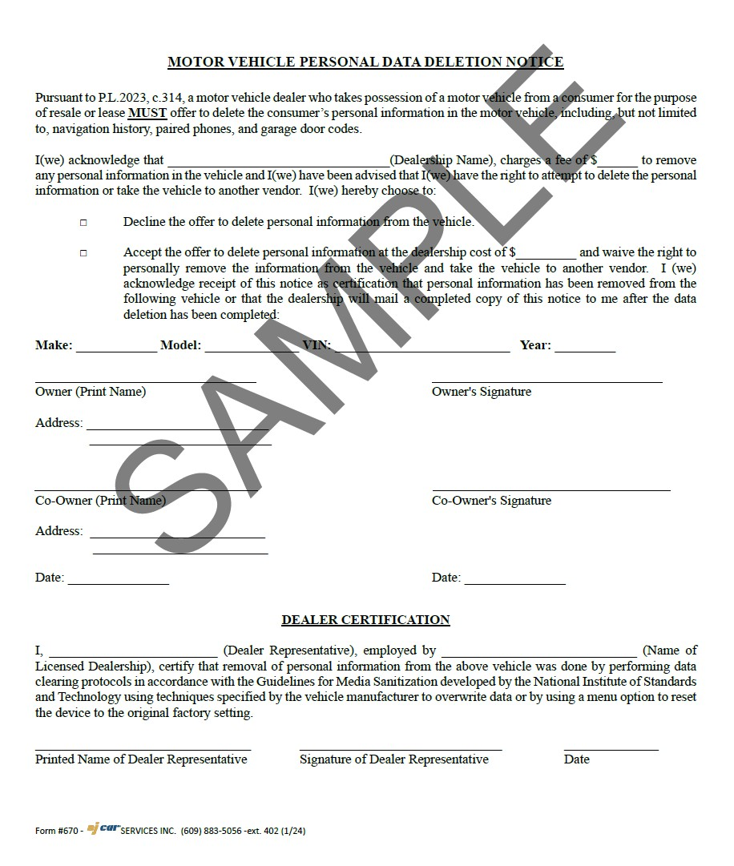
Grassroots Network

Slide 7
Dealership Options
Have Technician do the work at the dealership
Outsource to Third party Vendor
Grassroots Network

Slide 8
Have Technician Do the Work at The Dealership
Training
Reconditioning personnel
Technicians
Service manager
Inspection Check List
Safety
Mechanical
Adding Privacy
Access to E-Data
Google owner’s manual
NJCAR Exploring Other Resources
Grassroots Network
Notes:
1. Owner’s Manuals for different brands

Slide 9
Have Technician Do the Work at The Dealership
Responsible for Accuracy of work
Responsible Providing some certification
Assume Liability
Grassroots Network

Slide 10
Third party vendor
Reliability of work
Certification from a third-Party
Potential Transfer of liability
NJCAR Exploring Vendors
Grassroots Network
Notes:
Have vendors like Privacy4Cars with a product for dealers.
Comply Auto may be developing a program
There are also other vendors who may offer other solutions
Dealers will drive the market
Bottom line is either way dealers need a solution.

Slide 11
Discussion
What are dealerships Doing now?
Raise your hands to be unmuted
QUESTIONS – Type in the chat or raise hands to be unmuted
Grassroots Network

Slide 12
Contact Information
Greyson P. Hannigan
Director of Legal & Regulatory Affairs
Phone: (609) 883-5056 ext. 340
Email: ghannigan@njcar.org
Grassroots Network

